Slide 1



Preventing Severe Problem Behavior:
A Focus on Strengthening Socially Important Behavior
Gregory P. Hanley. Ph.D., BCBA-D
DataFinch
November, 2014
Notes:
Avoid the functional assessment process altopgether

Slide 2
Why wait for severe problem behavior to develop?
Teach functional skills to prevent problem behavior from developing or reemerging
Notes:
Some work at the university of Kansas in the early 2000s has taught me that we need not get rid of the proactive strategies but we need to compliment them with another approach, and this approach involves teaching functional skills to prevent problem behavior from developing or reemerging
Let me be clear what I mean by a functional skill….

Slide 3
Which skills?
All skills taught following effective functional assessment should be taught to all children and all persons with ASD
Notes:
All skills taught following effective functional assessment should be taught to all children, all persons with ASD, and all persons w/ intellectual disabilities. We have a sufficient amount of intervention research that is capable of informing large scale prevention of problem behavior.

Slide 4
Which skills?
Prevent problem behavior by teaching generalized repertoires for:
  Producing automatic reinforcers (i.e., play and leisure skills)
  Complying with typical instructions
  Recruiting and maintaining others attention
  Escaping or avoiding unpleasant situations
  Gaining or maintaining preferred materials or contexts
  Tolerating delays and denials of these same events/contexts
Notes:
Let’s prevent problem behavior by teaching generalizable repertoires for:
Producing automatic reinforcers (i.e., play and leisure skills)
Complying with typical instructions
Recruiting and maintaining others attention
Escaping or avoiding unpleasant situations
Gaining or maintaining preferred materials
Tolerating delays and denials of these same events
These items should be on all IEPs…forever…they are life skills; those in our care should never be passed on these general skills; the goals should simply be refined as people develop stronger and more flexible repertoires in each area. There are other important features of a comprehensive prevention program like promoting healthy sleep and eating, but teaching these skills everyday, throughout the day is, for me, the key to preventing the development of severe problem behavior.
And if you can successfully prevent severe problem behavior with a skills building approach, You can worry less about all of the assessment and treatment material reviewed earlier. You don’t have to assess or analyze problem behavior that never develops.

Slide 5
Key Factor:
Identifying and Setting up
Evocative Situations
Repeatedly introduce evocative situations and teach functionally equivalent skills
  Arrange low or divided attention-- teach requests for attention
  Arrange difficult or impossible tasks-- teach requests for assistance
  Arrange viewable but unattainable materials--teach requests for materials
  Arrange delays and denials of same events--teach tolerance
Notes:
A Key Factor with this prevention approach is that situations that may evoke problem behavior need to be routinely arranged and set up when teaching can occur. As opposed to avoiding challenging situations with the unfortunate and insidious antecedent-only approaches common in classrooms and preschools in particular.
With this approach, we arrange for low or divided attention periods and we use them to teach requests for attention
We arrange for children to experience difficult or impossible tasks, and we use these situations to teach requests for assistance or breaks
We arrange for materials to be in view but unattainable and we teach requests for materials
We then arrange for planned delays and denials of these same events, and we teach kids what to do when something important to them will be delayed or unavailable, we teach tolerance.

Slide 6

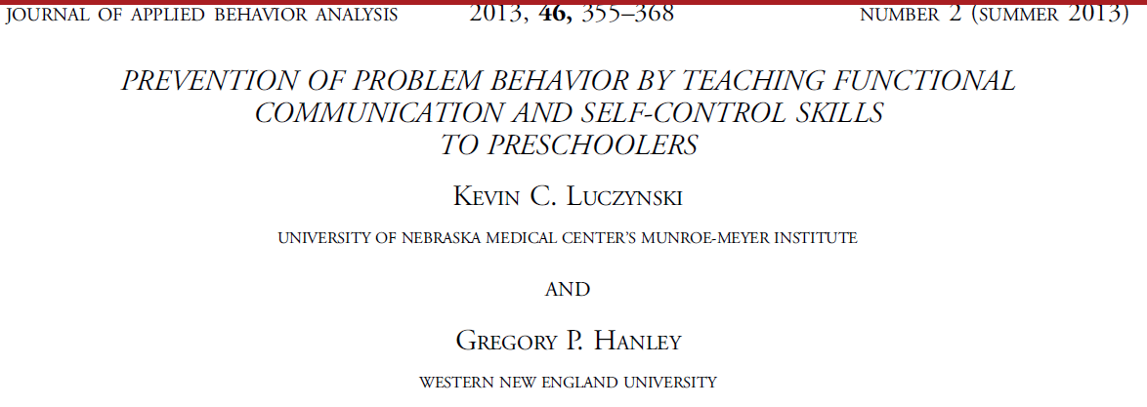
Prevention Model: A Start
Notes:
Our first attempt towards developing a curriculum to prevent problem behavior was published in JABA in 2007, and we have since replicated the effects of the curriculum in different school settings such as Head Start classrooms.

Slide 7
Study Summary and Implication
Summary:
  74% reduction of problem behavior
  4-fold increase in target skills
  Teachers report high overall satisfaction with the teaching strategies and the size of the effects
Take home point: Evocative situations should not be avoided in schools or homes; they should be introduced thoughtfully, systematically, and when skills can be taught.
Notes:
Some effects of the program are a reduction in existing problem behavior, large increases in target skills, and overall satisfaction by those implementing it.
The take home point here is that evocative situations should not be avoided in schools or homes; they should be introduced thoughtfully, systematically, and when skills can be taught.

Slide 8
Luczynski & Hanley (2013). Preventing the development of problem behavior by teaching functional communication and self-control skills to preschoolers. Journal of Applied behavior Analysis.
Notes:
A recent study by Kevin Luczyinski did, however, show the preventive efficacy of this approach as well as the trouble with avoiding evocative situations with young children.
In this study,12 preschoolers at risk for school failure due to functional skill deficits and early signs of problem behavior were randomly assigned to two groups:
6 kids experienced the life skills teaching program in daily small groups where they played games or worked on arts and crafts activities
6 other kids did not experience the life skills program but they did play the same games and worked on the same arts and crafts activities with the same people for the same amount of time.
The big difference between the groups was that challenging situations were programmed and skills taught for the treatment group; challenging situations were avoided and not programmed and therefore skills were not taught for the treatment group. For instance, multiple sets of materials were available in each activity, attention was freely available, caps were removed from the glue and markers, etc.

Slide 9
Luczynski & Hanley (2013). Preventing the development of problem behavior by teaching functional communication and self-control skills to preschoolers. Journal of Applied behavior Analysis.
Notes:
In addition to the randomized group design; single subject designs were used to show the effects of teaching with individual children in the treatment group. Here is the skill acquisition data for 1 child within a multiple probe design. Gaining teachers attention. Requesting materials or help. Tolerating delays and denials.
You can see that we measured these skills over time and they developed when and only when they were directly taught (in this case using behavioral skills training). These skills persisted even when the teaching package was removed.

Slide 10
Conclusion: These life skills do not occur without explicit teaching
They are as socially constructed as our alphabet
Notes:
Here are the data aggregated over time for each child in our initial baseline and our final maintenance phases. In baseline, the kids did not engage in these simple and very important skills. No child in the control group acquired the skills. No skills for either; strong skill development only for the kids in the treatment group.
The implication is clear. These skills do not occur without explicit teaching. Teachers cannot just expect these skills; they are as socially constructed as our alphabet and therefore require explicit teaching to occur with regularity.

Slide 11
Problem Behavior
Conclusion: Teaching the life skills prevented the development of problem behavior in these high-risk preschoolers
Notes:
Equally important were the effects on problem behavior. Despite occurring to a greater extent in the initial baseline than that observed in the control group, problem behavior was eliminated for all children in the treatment group. In other words, those who acquired the social skills no longer engaged in grabbing, yelling, hitting, talking rudely to each other or the teachers, etc. These same problem behaviors not only maintained for the children in the control group, they increased substantially for all children in the control group.
As the kids in the treatment group were being inoculated to challenging situations and learning skills to effectively manage those situations, the kids in the control group were being protected from the challenging situations and reaping the short term benefits associated with the noncontingent provision of reinforcers, but when the kids in the control group were put back into the challenging situations from baseline, they had developed no skills relevant to the situations and problem behavior swiftly resurged and maintained.
It is these data that lead us to conclude that teaching the life skills prevented the development of problem behavior in these high-risk preschoolers
Again, it seems that when we avoided evocative situations by providing children in the control group with noncontingent attention, materials, and assistance, we set the children up for problem behavior when these evocative situations were re-introduced in our final baseline probes. It is these data that make me leery of typical proactive approaches in which problem situations are altogether avoided.

