Slide 1



Functional Assessment of Severe Problem Behavior of Persons with Autism:
A Focus on a Safer, Faster,
and Still Effective Process
Gregory P. Hanley. Ph.D., BCBA-D
Datafinch
November, 2014
Notes:
It is an honor to be able to speak with you about some of the work that my students and I have been doing over the last decade to develop comprehensive and socially valid interventions for some of the more common problem behaviors associated with autism. Thanks to Drs. Coby and Janet Lund for this opportunity to share with you today.
9:30 to 11:00 for FA
11:00 to 11:45 for RX
11:45 to 1:00 Lunch
1:00 to 1:45 Rx Reflection and Prevention
1:45 to 4:00 Sleep

Slide 2
Autism is characterized by:
  Impairments in
  language development
  social interaction
  and
  Excessive repetitive behavior
Notes:
The latest estimate from the CDC is that about 1 in 50 children have been identified as having an Autism spectrum disorder is the US. There is no biological determination of autism; however, the behavioral symptoms are typically apparent before 3 years of age. Autism is characterized by impairments in social interaction and communication and by restricted, repetitive, or stereotyped patterns of behavior.

Slide 3
  With Autism, there is a higher likelihood of problem behavior
    Meltdowns
    Aggression
    Self-injury
    Chronic stereotypy
    Sleep problems
    References: Baghdadli, Pascal, Grisi, & Aussilloux, 2003; Horner et al., 2002; Kim et al., 2000; Murphy, Healy, & Leader, 2009; Thompson, 2009
Notes:
With Autism, there is a higher likelihood of problem behavior
Although a diagnosis of autism is not dependent on problem behaviors like meltdowns--those highly emotional outbursts and tantrums of extended duration that are clearly disproportionate to the circumstances--, aggression, or self-injury, the probability of one or more of these problem behaviors occurring with regularity is higher in children with autism than in children with other developmental disabilities.
For instance, researchers have reported a 10 to 15% prevalence rate of these problem behaviors in persons with an intellectual disability, By contrast, it was reported that 50% of a sample of 222 children with autism under the age of 7 engaged in self-injurious behavior; and that that 64% of a sample of 157 participants with autism aged 3 to 14 routinely engaged in at least one of the problem behaviors, with 32% of their sample showing all three behaviors.

Slide 4

  But,
  freedom
  from these behaviors
  for persons with Autism and their caregivers
  is attainable
Notes:
But, although these problem behaviors are highly prevalent among those diagnosed with autism, freedom for persons with Autism and their caregivers from these behaviors is attainable. This is an important take home message to share with any parent of a child with autism,

Slide 5
    It is attainable
    without drugs
    without hospitalization
    without harsh punishment
    without candies, stickers, and token boards

Slide 6
    It is attainable
    by first understanding why the child is engaging in the problem behavior
Notes:
There is an overwhelming buffet of options for understanding why behavior occurs. I will attempt to wittle down the options so that the process is fast, safe, useful—ultimately satisfying.

Slide 7
    It is attainable
    when children are taught skills to help them navigate our complex social world
Notes:
There is also an overwhelming buffet of treatment options, but I hope to convey the important point later this morning that just because we have shown functional control of problem behavior with an independent variable, does not mean that the IV should be routinely or possibly ever employed by practitioners to treat problem behavior.

Slide 8
    It is attainable
    while showing complete respect for their preferences
    without altering their rich and unique personalities
    (i.e., patterns of behavior)
Notes:
Describe parents concerns.

Slide 9
    It is attainable
    with proper assessment and treatment by a BCBA
Notes:
This process requires a solid understanding of reinforcement processes and single case experimental methods. This is not something to be exported to teachers for instance as much as it is something BCBAs need to learn to perfect.

Slide 10
Autism
Problem Behavior
*
Applied Behavior Analysis
*Main assumption
Severe problem behavior is understood as learned behavior influenced by its outcomes and context
Notes:
In a nutshell, the most important assumption of behavior analysis, and arguably the field’s greatest contribution is that severe problem behavior is understood as learned behavior …. Learned like any other behavior and that it is influenced by its outcomes, past and present, and by its present context. No matter how extraordinary the problem behavior may look or last, behavior analysts seek to identify and understand the ordinary conditions and interactions that gave rise to continue to strengthen the behavior.
Please understand that emphasis on the learned nature of problem behavior in children with autism does not mean that I blindly overlook genetics or the unique neurobiology of children with ASDs. These are important factors to read about at this point, but I would like to teach you to look where the light is good—to the children’s environment and especially to what the child experiences each time they engage in any important behavior--for variables responsible for their behavior.

Slide 11
To determine the personally relevant outcomes and context that influence problem behavior
behavior analysts conduct
functional assessments

Slide 12
What is a functional assessment?
(You can’t hold it in your hand)
  It is a process
    through which the variables influencing problem behavior are identified
Notes:
Process for determining the contingencies influencing problem behavior

Slide 13
Functional Assessment Process
Indirect Assessment an open ended interview with primary caregivers
Descriptive Assessment
brief observation
and casual interaction
Functional Analysis
Systematic observation within two different and carefully designed contexts
Test
Control
Notes:
A functional assessment is a process; a process in which the variables influencing problem behavior are identified prior to treatment and are used to inform the treatment development.
The process usually involves some sort of combination of indirect assessment, descriptive assessment, and functional analysis. Descriptive assessment involves observation and measurement of the problem behavior and its context; by contrast, functional analysis consists of observation and measurement of the problem behavior in at least two contexts, each distinctly designed from the interview so that the variables suspected of influencing problem behavior are conspicuously present in one (referred to as the test condition) and absent in the other (referred to as the control condition).
*Functional analyses of problem behavior are prominent in the behavioral assessment literature having appeared in over 400 studies through last year with almost a 1000 distinct analyses published.
In his review large review of treatments for problem behaviors associated with autism, Campbell found that larger reductions in problem behavior were clearly evident when a functional analysis was part of the functional assessment process.

Slide 14
  The functional analysis is integral to the success of the process
  Larger reductions in problem behavior were evident
  when a functional analysis was part of
  the functional assessment process
    Campbell, 2002; Kahng, Iwata, and Lewin, 2003
Notes:
These are not experimental techniques
*Functional analyses of problem behavior are prominent in the behavioral assessment literature having appeared in over 400 studies through last year with almost a 1000 distinct analyses published.
In his review large review of treatments for problem behaviors associated with autism, Campbell found that larger reductions in problem behavior were clearly evident when a functional analysis was part of the functional assessment process.

Slide 15
Why conduct a functional assessment?
In order to identify
an effective
precise
personally relevant,
and
humane treatment
for problem behavior
Notes:
You might not agree with me, so let’s do some perspective taking:
You experience some temporary muscle paralysis which does not allow you to talk or write or engage in controlled motor movements. You are now on many meds that dry out your eyes, your nose, your skin, and your mouth. Water is viewable, but unattainable. You learn that if you bang the bed rails long enough and loud enough people will give you things, one of which is the water. So the banging continues to such an extent that you are bruised and your caregivers annoyed. The consulting behavior modifier shows up and with a program of contingent restraint “to ensure your safety” and access to a radio and some skittles when you are not banging. ….Your problem behavior occurs much less frequently. It doesn’t go away, but your bruises are healing and the staff is certainly less annoyed with you. Job well done? I don’t think so.
If there were a tool available to allow your caregivers to know the simple reason why you were hurting yourself and annoying them, wouldn’t you want it employed. Wouldn’t it be great to just be able to push a button and get the water. The functional assessment process makes this humane and practical outcome possible. So let’s return to the earlier question and provide a better answer: Why conduct a functional assessment of problem behavior?
We do it, you should do it….**In order to identify an effective, precise, personally relevant, and humane treatment for problem behavior.
Why don’t most behavior analysts do it—many reasons for sure, but most likely because of the pervasive myths about the process.

Slide 16
  But,
  most people,
  including most practicing behavior analysts who work with children with autism
  have shied away from conducting
  functional analyses
Notes:
These are not experimental techniques
*Functional analyses of problem behavior are prominent in the behavioral assessment literature having appeared in over 400 studies through last year with almost a 1000 distinct analyses published.
In his review large review of treatments for problem behaviors associated with autism, Campbell found that larger reductions in problem behavior were clearly evident when a functional analysis was part of the functional assessment process.

Slide 17
  Why?
  Took too much time and resources,
  Never did one before (i.e., training issue),
  Seemed unsafe,
  Was unsafe,
  Often inconclusive
  Still ended up using behavior modification-based treatment
      i.e., arbitrary rewards in DROs
      & punishment
Notes:
There are no firm answers, but here are some that have been written about and are frequently offered:
Some say that they did it before, but it took too much time and resources
By contrast, some offer that they have never done one and do not feel comfortable doing one because they were never trained on how to do one
Some go further and opine that the analysis seems dangerous for both they and their clients
Others base this concern with safety on direct experience with a functional analysis that was indeed dangerous
Other have found that they were unable to obtain differentiated results
Even when differentiated results are produced, some offered that when all was said and done, they implemented a treatment that was very similar to the one they would have implemented had they not conducted an analysis

Slide 18

  It has taken a lot of research, but there are no longer obstacles to conducting functional assessments including functional analyses
Free pdf:
http://www.ncbi.nlm.nih.gov/pmc/articles/PMC3546636/pdf
Notes:
These are not experimental techniques
*Functional analyses of problem behavior are prominent in the behavioral assessment literature having appeared in over 400 studies through last year with almost a 1000 distinct analyses published.
In his review large review of treatments for problem behaviors associated with autism, Campbell found that larger reductions in problem behavior were clearly evident when a functional analysis was part of the functional assessment process.

Slide 19
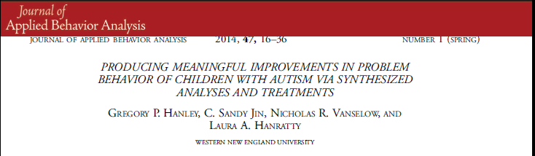
Notes:
This data-based article published this year in JABA.

Slide 20
Participants
Notes:
This bridge study involved 3 children…the first three served by our severe problem behavior clinic two years ago. They ranged in age from 3 to 11, were all on the autism spectrum, and all engaged in severe problem behavior in the form of meltdowns, aggression towards parents and siblings, screaming, and property destruction.

Slide 21
Outcomes (aggregated)
Notes:
Before we get into the procedural minutia, here are the outcomes for these children. High levels of problem behavior were directly observed in our baseline in the clinic (evident by the black bars). At the close of the assessment and treatment process, there were zero levels of problem behavior observed at the clinic and in the home, and social skills and compliance with adult instructions, that did not exist in baseline, were occurring at appropriate levels upon exit.
If I lose you in the minutia that follows, please just remember that Autism is not a life sentence of meltdowns, screaming, and aggression. These forms of behavior can be effectively eliminated while important social skills are learned via proper behavioral intervention. And this process can be efficient, occurring without major disruption to the child or family, and can be completely acceptable to parents.

Slide 22
Functional Assessment and Treatment Model
Steps (abbreviated)
1 | Functional Assessment Process
2 | Functional Communication Training
3 | Delay and Denial Tolerance Training
4 | Treatment Extension
Notes:
These are the general steps we take when addressing problem behavior of children with autism.
The first is the functional assessment, which, as I mentioned, is a process for figuring out why problem behavior is occurring by first interviewing caregivers and then directly testing out hunches regarding how the behavior is functioning for the child in what is termed a functional analysis. Treatment is then designed based on the results of the functional assessment process.
With treatment, we always teach the child a set of responses that serve the same function as the problem behavior, this is termed functional communication training.
Following FCT, we spend the majority of the time in the consultation process teaching children to tolerate periods of time when that for which they communicate is not available—we essentially teach them how to respond to cues of disappointment such as in a minute, hold on, later, not right now, and the big one, no,
We then extend the treatment to other relevant contexts and people.

Slide 23
Case Example (Gail, 3 yo, dx: PDD-NOS)
Hypotheses:
Gail engages in meltdowns and aggression in order to obtain:
(1) preferred (tangible) items,
(2) maternal attention,
(3) or both
Notes:
I will describe the assessment for Gail, the 3 year old girl first. Gail had long beautiful dark hair, her mother always dressed her impeccably, and Gail was quite excellent with dramatic play. The main issue was that she had 5 to 10 meltdowns per day that lasted from a few minutes to about an hour and it was difficult for her mother to ever predict which one was coming. She also was very aggressive towards siblings and parents, and highly noncompliant with adult instructions.
The interview suggested that Gail engaged in meltdowns and aggression in order to obtain preferred items (usually toys) and maternal attention. This is where I like to point out that extraordinary behavior is usually influenced by very ordinary events and interactions.
Our analysis then involves two conditions—the test, in which we try to emulate the conditions under which the problem has been reported to occur and the control, in which the factors thought to be responsible for problem behavior are removed. We alternate between 5 min test and control sessions in small observations rooms in our outpatient clinic at the university.

Slide 24
Case Example (Gail, 3 yo, dx: PDD-NOS)
Hypotheses:
Gail engages in meltdowns and aggression in order to obtain:
(1) preferred (tangible) items,
(2) maternal attention,
(3) or both
Notes:
As you can see, we failed initially to demonstrate our function hunch, so we asked her Mother to conduct the analysis and we saw differentiation between the test and control conditions. In other words, when Gail had continuous access to her preferred toys and her mothers undivided attention problem behavior was zero. When her mother intermittently withdrew these events and provided them only following instances of problem behavior, we see instances of these problem behaviors, which supports the hunch that Gail engages in problem behavior in order to obtain maternal attention and preferred items. It is important to note that these conditions are set up to emulate that which parents described to us and by ensuring that the putative reinforcers are delivered immediately and for the initial instances of problem behavior, we do not see intense, persistent, or dangerous problem behavior in our analyses.

Slide 25
Case Example (Gail, 3 yo, dx: PDD-NOS)
Hypotheses:
Gail engages in meltdowns and aggression in order to obtain:
preferred (tangible) items,
And maternal attention,
Notes:
We went on to show that Gail’s problem behavior was sensitive to both tangible items and attention when combined as reinforcement and only when provided by her mother.

Slide 26
Case Example (Bob, 8 yo, dx: Autism)
Hypothesis:
Bob engages in meltdowns and aggression in order to obtain:
“His way” in the form of escape from adult instructions and access to preferred ways of interacting with electronics or academic materials
Notes:
This case example involves an 8 yo boy diagnosed with autism. He was fair skinned, red headed, hefty, uniquely gifted in math, had a great smile and very loving parents. School administrators were at their wits end attempting to educate Bob and his parents rarely left the house with him other than to take him to school because of his meltdowns.
The 50-min interview showed that problem behaviors (yelling, hitting, throwing or destroying property) occurred whenever Bob did not get his way. Problems occurred especially when someone played the “wrong” apps or “wrong” way on an ipad or when someone did math incorrectly or corrected his way of doing math.
Our analyses showed this to indeed be the case. For instance, in the math context control condition, Bob was allowed to complete his math worksheets in any way he wanted, uninterrupted and never corrected. By contrast, prompts to do a particular math problem a particular way were provided and if he had problem behavior he was allowed to do it his way for 30 s in the test condition. We only saw problem behavior in these test sessions.

Slide 27
Case Example (Dale, 11 yo, dx: Autism)
Hypothesis:
Dale engages in meltdowns and aggression in order to obtain:
“His way” in the form of escape from adult instructions and access to preferred (tangible) items, and adult attention.
Notes:
Dale was an 11 yo boy with autism who was essentially running the show at home. He was very demanding and when his requests were not honored, he would scream or become aggressive or destructive. In our test condition, we prompted Dale to complete homework and any problem behavior resulted in our terminating the prompts allowing him to walk away and watch a movie and we honored any of his requests during this “break” from homework. During the control condition he had access to his way the whole time (a permanent break with access to preferred items, adult interaction). You can see that we were able to turn his problem behavior on and off in the analysis confirming the hunch about the function of his problem behavior from the interviews.

Slide 28
Some Important Aspects of our Approach
Extensive descriptive assessments are never part of the process
because they are:
time-consuming
and usually suggest invalid relations
St. Peter et al., 2005; Thompson & Iwata, 2007
Notes:
Why are these analyses so fast, safe, and effective?
It is not because they were preceded by long periods of observation or informed by the correlations that result from those observations.
Pause

Slide 29
Some Important Aspects of our Approach
2. Closed-ended indirect assessments (MAS, QABF, FAST) are never used in the process
because they do not provide any information about personally unique or qualitative features of potentially influential variables
Notes:
It is not because the analysis was preceded by a closed ended indirect assessment like the FAST or MAS or QABF. These were not conducted
because their results teach us nothing interesting, specific, or unique that we can then include in our analyses.

Slide 30
Some Important Aspects of our Approach
3. An open-ended interview is always part of the process (as is one brief and informal observation)
Goals of interview are to:
  Develop rapport with parents or teachers
  Identify idiosyncratic aspects of contingencies
  Develop “function hunches”
  Set up a safe and efficient analyses
Interviews allow for discoveries which can then be verified (or not) in a functional analysis
Notes:
Our analyses are fast, safe, and effective for building treatments because they are informed by parents and teachers through our open ended interviewing. The interview we use is available in the review article I mentioned earlier and hard copies will be available here along with a summary of this presentation.
The take home point here, is interviews allow you to discover variables whose importance can be verified, or not, in a subsequent analysis.

Slide 31
Some Important Aspects of our Approach
4. A standard 4 or 5 condition analysis (with the play condition as the control, e.g., Iwata et al., 1982) is never part of the process
Probably a mistake to standardize a powerful and flexible tool like a functional analysis
Notes:
It is probably evident at this point that a standard multielement analysis is never part of our assessment process.
We think that is a mistake to standardize a powerful and flexible tool like a functional analysis, but we also think that when behavior analysts commit to a standard analysis, that I will define in a moment, they are committing to long, possibly unsafe process that often yields undifferentiated results.

Slide 32
Some Important Aspects of our Approach
5. A two-condition analysis designed from the open-ended interview is always part of the process (i.e., an interview-informed analysis)
Functional analysis:
Direct observation of behavior under at least two conditions in which some event is manipulated
Two Conditions:
Test: Contains the contingency thought to maintain severe problem behavior
Control: Does not contain the contingency thought to maintain severe problem behavior
Notes:
Instead we commit to a 2 condition, test control analysis designed from our open-ended interview. These are still functional analyses in which the contingency thought to maintain severe problem behavior is programmed in the text condition and is removed from the control condition.

Slide 33
Some Important Aspects of our Approach
6. We synthesize multiple contingencies into one test condition, if the interview suggests the contingencies are operating simultaneously
Notes:
And last, we synthesize multiple contingencies into one test condition, if the interview suggests the contingencies are operating simultaneously

Slide 34
Why might problem behavior occur?
Single contingencies:
Attention or toys (social-positive reinforcement)
Escape/avoidance (social-negative reinforcement)
Sensory/non-social (automatic reinforcement)
Combinatorial contingencies:
Attention and Toys
Escape to toys
Escape to toys and attention
Escape to automatic reinforcement
Compliance with mands
Escape to access to rituals, preferred conversations
Escape to control (?)
Etc…..
Notes:
In other words, instead of searching for the isolate effects of generic contingencies, we ask questions about contingency combinations that are alluded to or even explicitly described in our interviews.
Essentially we have moved towards replacing the “or” from above (is it maintained by escape, toys, or attention?) with an “and” (is it maintained by escape to toys and attention?).
Said another way: Instead of searching for the main effects of generic contingencies, we are searching for the effects of interactions among several contingencies. The premise here is that we are trying to emulate the ecology that is responsible for the maintenance of the problem behavior, and we think that ecology is more likely to be composed of interacting contingences than isolated ones.

Slide 35
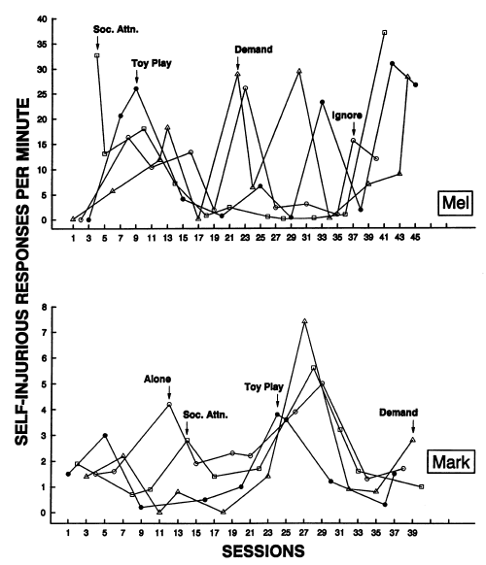
Some standard analyses published a while ago
Notes:
Here are some analyses I had the opportunity to conduct and publish in the 90s while at the Kennedy Krieger institute.
Note how many sessions were required
Note the variability in the data

Slide 36
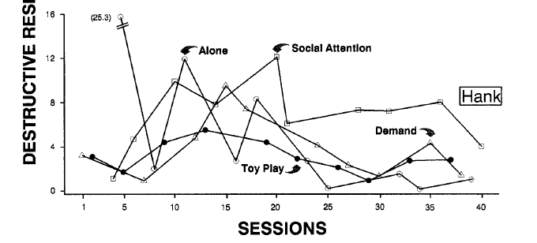
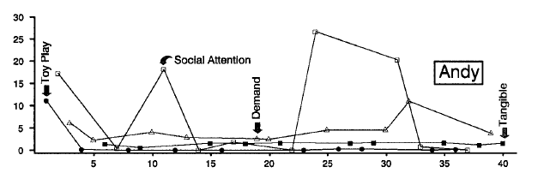
Some standard analyses published a while ago
Notes:
Even when differentiated, note the variability, especially in the control condition, and again how many sessions were required.

Slide 37
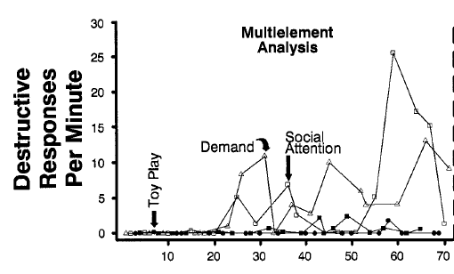
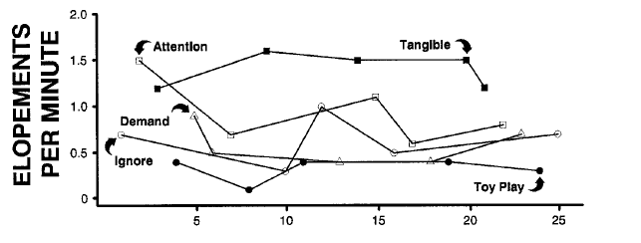
Some standard analyses published a while ago
Notes:
Here as well

Slide 38
Analyses conducted within a 6- month time span (2012-2013)
Notes:
Here are the results of 16 interview-informed synthesized contingency analyses
They include children and adults
With and without autism
They were conducted in our clinic, or in others classroom, vocational sites, or homes
And they were implemented by people with much or very little experience with functional assessment
Note the smaller number of sessions required.
Note the smaller amount of variability, especially in the control condition sessions.
We have since consulted with over 15 service centers in multiple countries and have witnessed effective analytic outcomes in over 100 applications.

Slide 39
Important characteristics of
interview-informed and synthesized analyses:
they are short, safe, and successful
due to the:
  provision of all ecologically relevant reinforcers immediately and for every problem behavior (precursors and dangerous behavior) in the test condition
  reliance on a “No EO” (continuous Sr) control condition
Notes:
The main result of the synthesis, and building that which is synthesized from an open-ended interview, is that our analyses are short and safe.
This efficiency and safety of these analyses is probably due to the facts that in the test conditions all likely reinforcers are provided immediately and for every problem behavior, both precursors and dangerous behavior
Let me unpack this:
There are two effects of reinforcement on problem behavior—one parents appreciate more than us and one we appreciate more than parents. We appreciate the one in which reinforcement increases the probability of a similar behavior occurring again under similar conditions in the future. But parents have learned to appreciate the one in which reinforcement immediately terminates a behavior, and it is this latter effect of reinforcement that is so important to the design of safe analyses.
If problem behavior is maintained by escape and tangibles and you go into test session and only provide escape, the establishing operation for tangible reinforcement is still operating and is likely to evoke problem behavior, during the “reinforcement interval” and you will have nothing at your disposal in that “demand” condition to turn off that problem behavior. This leads to unsafe analyses in which problem behavior escalates and sessions get terminated or people get hurt. By contrast, by providing all suspected reinforcers simultaneously, you turn off behavior during reinforcement intervals in test sessions and during the entire control condition.

Slide 40
An unfortunate standardization of functional analysis has developed in last 10 years
Standard Functional Analysis:
Multiple test conditions
Uniform test conditions
Isolated test conditions
Toy-play control conditions
Notes:
Joshua Jessel, a brilliant graduate student at Western New England University, reviewed the 450 or so publications that included functional analyses and took notes on some key methodological features that were not described in previous reviews of this literature and that seemed to have become hallmarks of a standard functional analysis approach. He separated his counts by early articles and more recent articles. And he found that multiple test conditions are more likely in analyses of the last decade than they were historically. He found the same for the use of uniform (generic) test conditions, and isolated test conditions. In other words, more synthesized contingencies happened between 1965 and 2000 than in the last decade of published analyses. He also found greater embrace of a generic and omnibus control condition in the last decade than reliance on an intimately matched control condition.
The point is that an unfortunate and accidental standardization of functional analysis has developed in last 10 years.

Slide 41
Consider an
Interview Informed
Synthesized Contingency Analysis
IISCA?
Interview-informed Synthesized Contingency Analysis
Single-test condition
Individualized test conditions
Synthesized contingencies
Test-specific control
Reinforce precursors to and dangerous behavior
Standard Functional
Analysis
Multiple test conditions
Uniform test conditions
Isolated test contingencies
Toy-play control conditions
Reinforce dangerous behavior
Notes:
So, I am suggesting that….rather than conduct a standard functional analysis, that you consider an interview-informed synthesized contingency analysis: here are its hallmarks:
;
;
;
;
When you do an analysis, please reinforce precursors to and dangerous behavior This too is not an “or” situation. If you go into the analysis with the plan to only reinforce dangerous behavior, eventually you will be experiencing a lot of dangerous behavior. If you go into the analysis with the plan to only reinforce precursors, and dangerous behavior occurs and you don’t reinforce it, the dangerous behavior will likely escalate. If you go into the analysis with the plan to provide the suspected reinforcers for both precursors and dangerous behavior, you will turn off dangerous behavior and eventually be experiencing precursor behavior.

Slide 42
Towards a more efficient analysis
Notes:
Josh also calculated how long it took to conduct analyses of different formats by multiplying session durations by the number of sessions or trials conducted in published analyses.

Slide 43
Towards a more efficient analysis
Notes:
He found that standard analyses as I previously defined and which are more common nowadays than ever before in our published literature, take an average of 5.5 hours, meaning half have taken longer than that.
IISCAs have thus far required an average of 22 minutes to conduct.

Slide 44
Levels of Analytic Control
Strong
Test condition: Consistently elevated rates
Control condition: Zero or near-zero rates
Moderate
Test condition: Some zeros or near-zero rates
Control condition: Zero or near-zero rates
Weak
Test Condition: Variable but higher rates
Control condition: Lower but non-zero rates
Notes:
Analytic or experimental control of behavior is often considered a binary dimension; In other words you either have demonstrated experimental control or you have not.
But most visual inspectors of data come to understand that there are also varying degrees of experimental control and these varying degrees can be measured and it is important to consider them because of the implications of exerting strong or weak control in functional analyses.
So while reviewing the same functional analysis literature, Josh also scored analyses based on how much control was exerted over the problem behavior in each type of analysis.
Here are the definitions with representative analyses:

Slide 45
Towards a more controlled analysis
Notes:
And here is the percentage of applications of the different functional analysis formats that exerted strong, moderate, weak or experimental control of behavior. Control is often not demonstrated in what is usually termed brief analyses or in trial based analyses. The more important finding however is that the standard analysis yields weak control of problem behavior in just over half of the analyses. By contrast, strong control over problem behavior is demonstrated in 88% of the interview-informed synthesized contingency analyses.
You might be thinking-- who cares --a differentiated analysis is good enough, is it not?

Slide 46
Interpretation and Implications of Varying Levels of Analytic Control
Strong experimental control
Interpretation: Have access to all reinforcers and EOs
Implication: Can turn off problem behavior with
reinforcement; should achieve meaningful outcome with only function-based treatment
Notes:
Here is why I think it matters:
When you have strong experimental control in a functional analysis you presumably have access to all reinforcers and EOs relevant to problem behavior, at least in the analytic setting. The implication is that because you were able to turn off problem behavior with reinforcement in the analysis, you should be able to achieve meaningful outcomes with only function-based treatment.

Slide 47
Interpretation and Implications of Varying Levels of Analytic Control
Moderate experimental control
  Interpretation: Some other EO is probably uncontrolled and interacting
  Implication: Skill development may be slower as motivation may vary across sessions, but should achieve meaningful outcome with only function-based treatment
Notes:
When you have moderate experimental control, it seems that some other EO is probably unaccounted for and is probably interacting with the programmed contingency.
The implication of this type of control is that skill development may be slower as motivation may vary across upcoming treatment sessions, but you should still should achieve a meaningful outcome with only function-based treatment, again the process just might be a little slower than if you had stronger control of behavior.

Slide 48
Interpretation and Implications of Varying Levels of Analytic Control
Weak experimental control
  Interpretation: All reinforcers for problem behavior are not identified
  Implication: Variable responding will persist throughout skill development, probably necessitating punishment or arbitrary reward system
The necessity of punishment when function-based treatments are made more practical is commonly reported:
Fisher et al., 2003, Hagopian et al.,1998, Hanley et al., 2005, Wacker et al., 1990
Notes:
When you have weak experimental control, which is most likely the result of a standard analysis, it is apparent that all of the reinforcers have not been identified. The implication of this type of analytic control is that variable levels of problem behavior will probably persist while functional replacement skills are being developed thus necessitating at one point or another some sort of punishment or arbitrary reward system.
The necessity of punishment to maintain near zero rates of problem behavior when function-based treatments are made more practical is no secret.
Folks: We have been frequently basing treatments off of these types of functional analysis baselines since the advent of functional analysis.
Despite the significant presence of functional analyses of problem behavior in our research literature for over 30 years, people with intellectual disabilities or autism who engage in severe problem behavior are still being treated with punishment and arbitrary reinforcement within token programs.
I think it is because we are treating off these baselines in which problem behavior is weakly controlled----- why is it weakly controlled, because historically we have not accounted for all of the personally relevant reinforcers for problem behavior when we design our treatments. When all reinforcers are not managed, in other words provided differentially, the establishing operation for one or more reinforcers is present and evokes problem behavior even while our function-based treatment is implemented with integrity.

Slide 49
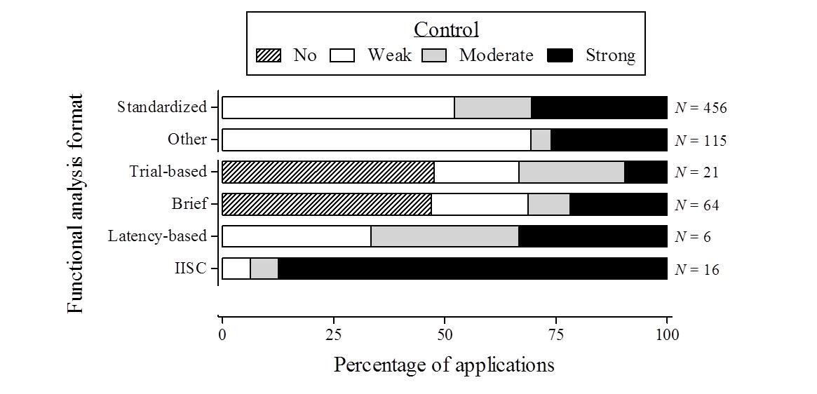
To achieve the humane outcomes that are possible with exclusive reliance on function-based treatments,
it is important that we do everything we can to exert strong experimental control in our analyses.
Notes:
The point here is that in order to achieve the humane outcomes that are possible with exclusive reliance on function-based treatments,
it is important that we do everything we can to exert strong experimental control in our analyses.
Interview informed synthesized contingency analyses yield strong experimental control in most applications.

