Slide 1



Treating Severe Problem Behavior:
A Focus on Strengthening
Socially Important Behavior
of Persons with Autism
Gregory P. Hanley. Ph.D., BCBA-D
DataFinch
November, 2014
Notes:
It is a treat to be able to speak with you tonight about some of the work that my students and I have been doing over the last few years to develop comprehensive and socially valid interventions for some of the more common problem behaviors associated with autism.

Slide 2
Functional Assessment and Treatment Model
Steps (expanded)
1 | Interview
2 | Functional Analysis
3 | Functional Communication Training
4 | Complex FCT
5 | Tolerance Response Training
6 | Easy Response Chaining
7 | Difficult Response Chaining
8 | Treatment Extension
Notes:
So at this point, we have come to some understanding as to why problem behavior occurs and have taught a replacement behavior but we are far from being done because this is not a treatment that can be handed off to parents at this point. The real challenging part of the process is that which follows. Due to time constraints, I will describe it in detail only for Dale.

Slide 3
Treatment Analysis
Dale
11-year old boy
diagnosed with Autism
Notes:
We see similar results with Dale, high rates of the communication response, much less problem behavior but it was not eliminated initially as it had been for Gail and Bob. This is primarily because he would make some extraordinary request that we could not honor (like entering into an ongoing class to check out what was on the classroom laptop). Nevertheless, we are off to a good start towards treatment.

Slide 4
Treatment Analysis
Dale
11-year old boy
diagnosed with Autism
Notes:
The next steps are really to increase the developmental appropriateness of the situation, teach some transferrable skills, and arrive at some balance in the social arrangement between adults and children.
More specifically, we teach a more complex communication exchange that goes something like this. Before Dale’s “My ways” were acknowledged he had to obtain our attention by saying “excuse me” He then was taught to say “May I have my way please”. You can see he acquired the more complex functional communicative response and problem behavior was at zero.

Slide 5
Treatment Analysis
Dale
11-year old boy
diagnosed with Autism
Notes:
We then introduced the common context of a parent delaying or denying Dale his way by saying wait, no or later following about 40% of his way requests. If he had problem behavior, we caved and gave him his way. We see the FCR persisting but we also see an immediate return to baseline levels of problem behavior.

Slide 6
Treatment Analysis
Dale
11-year old boy
diagnosed with Autism
Notes:
These additional measures also convey how far we are from a meaningful intervention. The top graph shows the percentage of time Dale is in reinforcement or having his way and it is between 50 and 75% of the time. Also, he is still not complying with even simple instructions which is evident by these skinny white bars.

Slide 7
Treatment Analysis
Dale
11-year old boy
diagnosed with Autism
Notes:
We then taught Dale an explicit response to the delay and denials and that was to “take a deep breath and say Okay while looking at the adult”. Once he engaged in the tolerance response, we allowed him “his way time”. (Just say okay and you can have it your way) You can see problem behavior returning to near zero levels as he starts engaging in this tolerance response.
I want to point out that while we are teaching these skills, we are careful about evaluating the effects of treatment within single subject experimental designs. For instance, we have shown functional control of problem behavior within a reversal design here. We have shown functional control over the skill acquisition in a multiple baseline design by showing that the social skills occur when and only when a reinforcement contingency is arranged. We employ single subject experimental designs to make sure that the behavioral improvements are indeed a function of what we are doing and will be recommending to parents when our consultation is over.

Slide 8
Treatment Analysis
Dale
11-year old boy
diagnosed with Autism
Levels
1 | Simple motor movements | Walk over here, stand up, sit down, clap your hands, touch your (shoulder, head, toes)
2 | Simple academics | Draw a circle, write your name, copy what I write
 | Homework/Task preparation | Unzip your backpack, take out the book, erase the board come to the board, put these books on the book shelf
3 | Complex academic: Reading skills | Read this paragraph, Answer this question…., Sound out the words
 | Complex academic: Math skills | Solve this (addition, subtraction etc…)
 | Self-help skills | Wash your hands, do this chore (e.g., organizing chairs)
 | Play skills | Throw or kick the ball
Notes:
Our next step was to initiate the response chaining portion of his intervention where we gradually increase the complexity of the instructions issued to him and the amount of time before the denied reinforcer is provided for his communication.
As you can see the percentage of time in reinforcement gradually decreases, the complexity of the instructions increases until we are issuing instructions that are age-appropriate and of the ilk his parents reported as most troublesome. The thicker bars here show that he is complying with the instructions the great majority of the time.

Slide 9
Treatment Analysis
Dale
11-year old boy
diagnosed with Autism
Notes:
During this period his problem behavior is generally low and towards the end at zero for 6 consecutive sessions while his communication and tolerance skills are persisting.

Slide 10
Treatment Analysis
Dale
11-year old boy
diagnosed with Autism
Notes:
At this point we extend the treatment to parents and to different contexts including the home. Yes, we still make house calls. During this transition, his repertoire is right where we would like it to be.

Slide 11
Treatment Analysis
Dale
11-year old boy
diagnosed with Autism
Three analysts alternated while parents observed the sessions
Following training, the father was introduced after the analyst presented the evocative trial and halfway through the session; the mother was present in the session room
The mother implemented treatment in the session room
Parents varied the type and amount of instructions during the delay period
Parents implemented treatment in the home while novel instructions were introduced
Notes:
And the reinforcement level is low and his compliance with developmentally appropriate instructions is high. Here I have noted some of the gradual steps we took in transitioning the treatment to the parents and into the home.
Talk about wish list (retaliation list) and outcomes for Gail and Bob

Slide 12
Notes:
These same steps are followed with all of our clients who present with severe problem behavior and noncompliance and to similar effect.

Slide 13
Time Assessment
Notes:
Here I depicted the amount of visits required to complete each step in the process. You can see that between 23 and 32 1-hr visits were required to eliminate problem behavior, teach several important life skills, and move the effective treatment into the home or school.

Slide 14
Cost Assessment
Notes:
Taking into account the going rates of the behavior analysts working together during this process, the projected cost for these outcomes is between 6 and 9000 us dollars.
Considering the much higher costs of inpatient psychological services (which is about $8000 per day), out-of-district educational placements (which cost between 80 and 130,000 per year), or long-term supported care for individuals with autism, which was estimated to be 3.2 million dollars across their lifetime, proper assessment and treatment of these problem behaviors while children with autism are young seems a reasonable investment.
This process costs about the same as a family of 4 week long vacation in Disneyworld, about the same as smoking 2 packs a day in Massachusetts, or about the same as getting the navigation, moon roof package, and wood paneling package in an SUV.

Slide 15
General Social Validity Data
Notes:
The same treatment process was replicated with Gail and Bob. At the conclusion of treatment, families returned to the outpatient clinic to complete a social validity questionnaire and to ask any questions about treatment implementation. All parents reported that they found the assessment procedures and treatment packages highly acceptable, the improvement in problem behavior highly acceptable, and overall consultation very helpful.
It not only works well and leads to general outcomes but people like the process and outcomes and it is these data that my research and practice group is most proud of.

Slide 16
Personalized Social validity Data
Notes:
When asked about their comfort level with presenting the specific situations that were initially reported to evoke problem behavior, ratings improved for all parents between the initial and their last meeting with the behavior analyst and the parents reported being very comfortable with presenting evocative situations after being trained on the treatment.

Slide 17
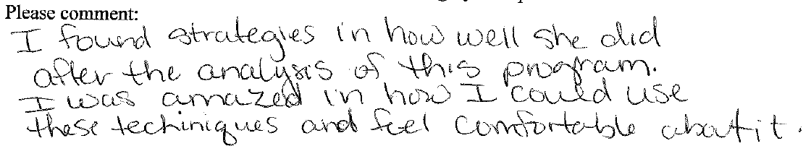
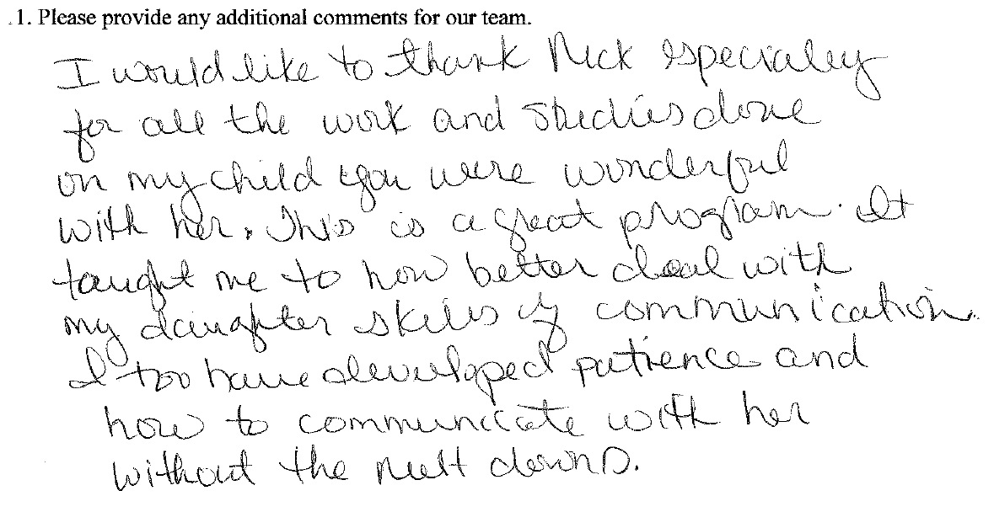
Some open-ended responses from the Social Acceptability Questionnaire

Slide 18
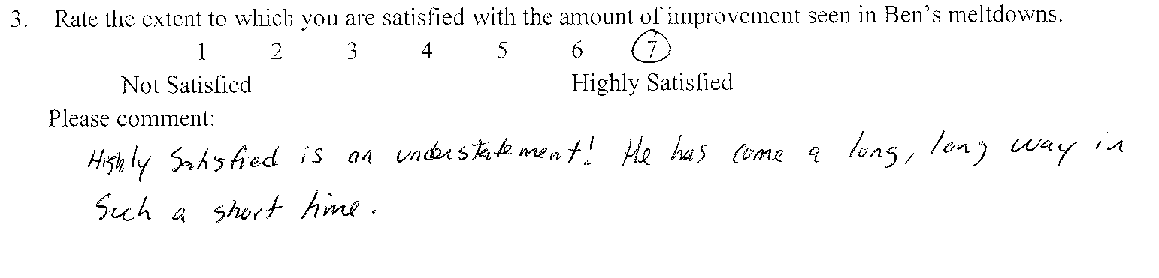
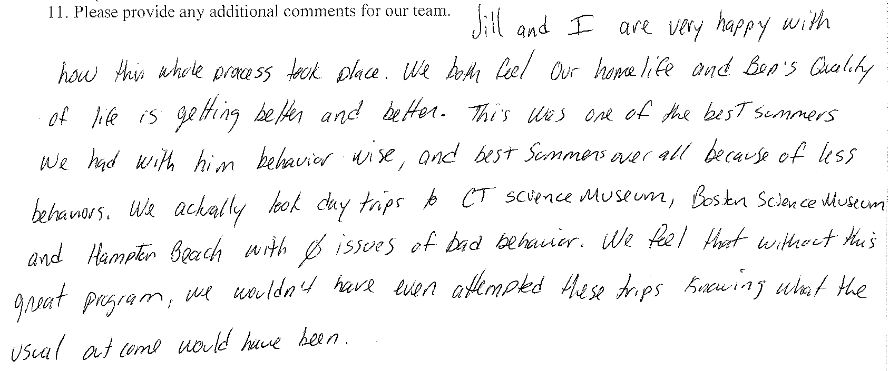
Notes:
These are two of the more legible responses to open-ended questions.

Slide 19
Implications
If the problem behavior occurs with regularity, it is being reinforced
Solution involves four main steps:
Identify the reinforcing contingency for the problem behavior
Replace problem behavior by providing the functional reinforcer for socially acceptable alternatives
Teach child to tolerate (intermittent and unpredictable)periods when the reinforcer is unavailable
Extend treatment to relevant people and contexts
Notes:
Let me sum up the implications:
If problem behavior occurs with regularity in a child with autism, it is being reinforced. It is a simple but powerful assumption because it leads to quick assessment and personalized treatment of the problem.
Solution involves four main steps:
Identify the reinforcers
Teach them better ways to get those reinforcers
Teach them to handle when they can’t have those reinforcers
Train others how to continue with these teachings

Slide 20
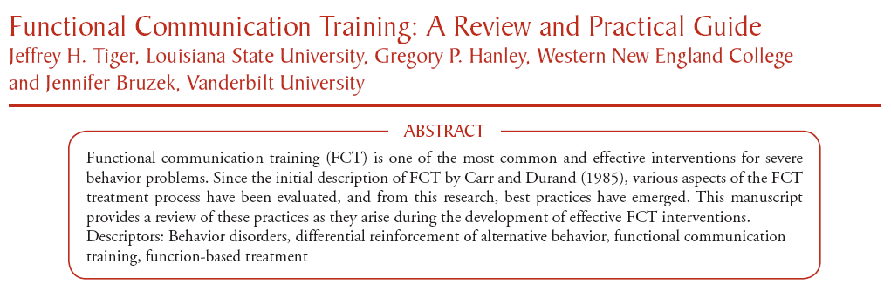
Ten Unique Aspects of our Approach (continued)
7. Our function-based treatments are always skill-based
Published in Behavior Analysis in Practice in 2008
(available for free at PubMed Central)

Slide 21
Ten Unique Aspects of our Approach
8. We always increase the complexity, flexibility, and/or interactional nature of the FCR before teaching delay/denial tolerance
Simple FCR: (“My way” or “My way, please”)
Complex FCR:
“Excuse me”
After a second or two, “Yes, Billy”
“May I have my way, please?”
“Will you play my way, please?”
After a second or two, “Sure, Billy”
Notes:
Don’t need extinction here, could provide more immediate, longer, and higher quality reinforcers for complex FCR and delayed shorter and lower quality functional reinforcers for the simple FCR.

Slide 22
Ten Unique Aspects of our Approach
9. We always explicitly teach delay/denial tolerance
This takes up most of our time with children and families (not the functional assessment or teaching the FCRs)
First teach an explicit response to a variety of disappointment signals, then to make treatment practical:
Chain important behavior to the tolerance response
(there is always a progressive component—a gradual increase in time, stakes, or both)

Slide 23
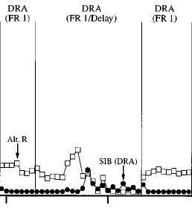


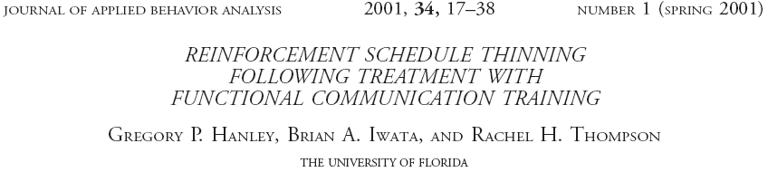
With only Progressive Reinforcement Delay:
As delay increases, FCR weakens & probability of PB increases
Notes:
As the delay increases, the newly acquired alternative response starts to diminish and, in this case, self-injury re-emerges.

Slide 24
Time-based vs. Contingency-based Progressive Delay (Lead Author: Mahshid Ghaemmaghami)
Notes:
2 to 3 min delay

Slide 25
Time-based vs. Contingency-based Progressive Delay (Lead Author: Mahshid Ghaemmaghami)
Notes:
2 to 3 min delay

Slide 26
Time-based vs. Contingency-based Progressive Delay (Lead Author: Mahshid Ghaemmaghami)
Notes:
2 to 3 min delay

Slide 27
5 Critical Aspects of Delay/Denial Tolerance Training
Always provide immediate sr for some FCRs
Teach an appropriate response to multiple cues of delay, denial, or disappointment
Progressively increase the average amount of behavior (not just time) required to terminate the delay
Terminate the delay for various amounts of behavior (sometimes expect very little behavior sometimes request larger or more complex types of behavior during the delay)
Probably best to not signal how much behavior is required to terminate the delays
Notes:
How do we achieve high social acceptability ratings?

Slide 28
Ten Unique Aspects of our Approach
10. We work hard to ensure that the process is agreeable and outcome is meaningful to both children and parents
Have parents witness and take part in the entire process
Keep working with child until the wish list goal is met
(e.g., going to Six Flags as a family)
Notes:
How do we achieve high social acceptability ratings?

Slide 29
Please share this Take-Home Point
Autism is not a life sentence of:
Meltdowns
Aggression
Self-injury
Notes:
And last, as practitioners, we are not done treating automatically-reinforced stereotypy until it goes away when that someone is alone. When it goes away in the baseline from which we found the behavior.
This is a tall order, this is not something that can be completed in a few months. This is a long term commitment. But, I am confident it can be done…because we have seen it happen with children in good EIBI programs after a 2 to 3 years of solid intervention.
These long-term evaluations of stereotypy treatments are that which is now needed to determine if behavior-analytic technology is essential for treating these very common, intractable behaviors associated with autism.

Slide 30

Freedom from these problem behaviors is possible and probable with:
BCBA-led, objective analysis
Skill-based treatments yielding functional reinforcers
Contingency-based delay tolerance procedures
Notes:
And last, as practitioners, we are not done treating automatically-reinforced stereotypy until it goes away when that someone is alone. When it goes away in the baseline from which we found the behavior.
This is a tall order, this is not something that can be completed in a few months. This is a long term commitment. But, I am confident it can be done…because we have seen it happen with children in good EIBI programs after a 2 to 3 years of solid intervention.
These long-term evaluations of stereotypy treatments are that which is now needed to determine if behavior-analytic technology is essential for treating these very common, intractable behaviors associated with autism.

